Slide 1
Welcome to Mr. Bisbee’s 8th Grade American History Classroom

Slide 2
A little bit About me
Born and raised in Pierre South Dakota
Graduate of Augustana College where I also played football.
This will be my 17th year teaching in the Brandon Valley School District
Coaching – This will be my 16th year on staff coaching the Offensive Line for our Varsity Football program and my 17th year coaching 8th grade boys basketball.

Slide 3
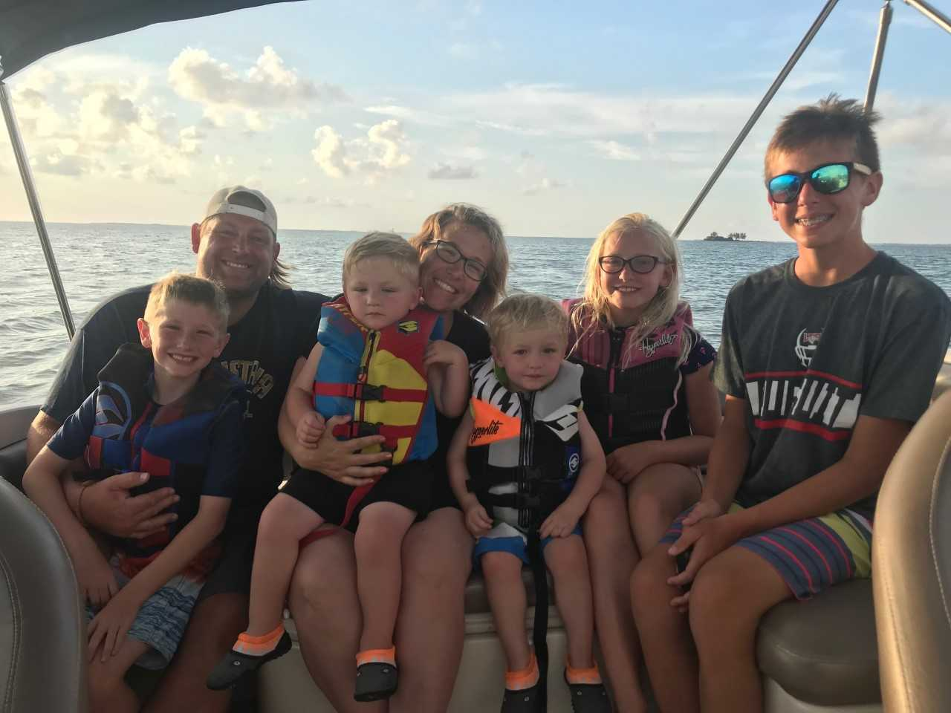
A little bit about my family
My wife Erin teaches first grade at Fred Assam Elementary
My oldest son Tristan, is 14 and a 9th grader
My only daughter Adelyn, is 11 and a 6th grader
My middle son Nolan, is 9 and a 4th grader
My twin boys Lincoln and Ryan are 3 ½ years old AND ARE DEFINITELY IN CHARGE AT OUR HOUSE!!

Slide 4
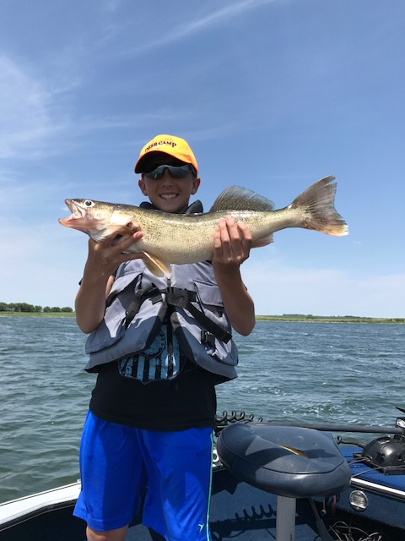
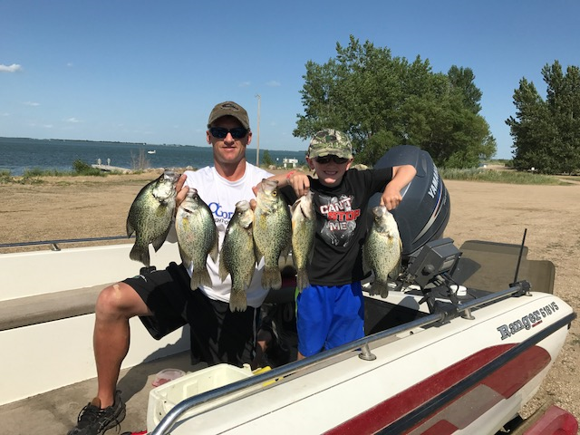
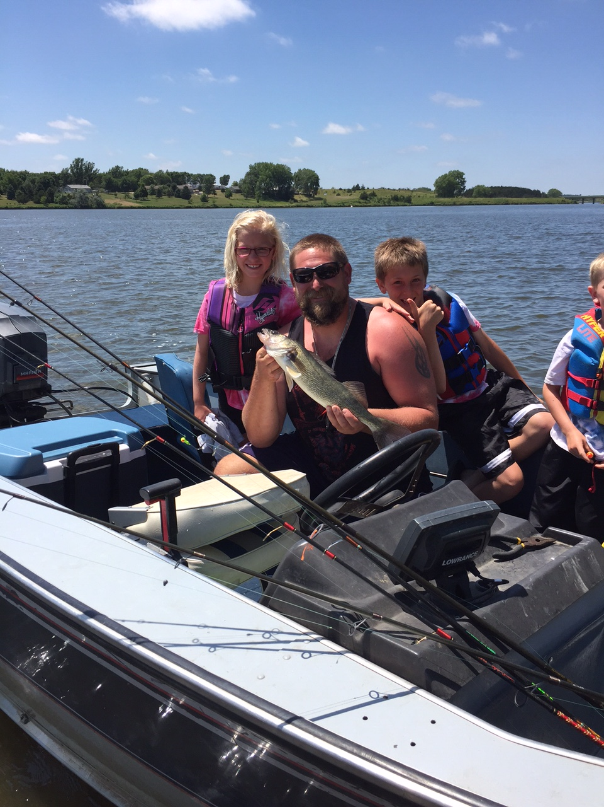
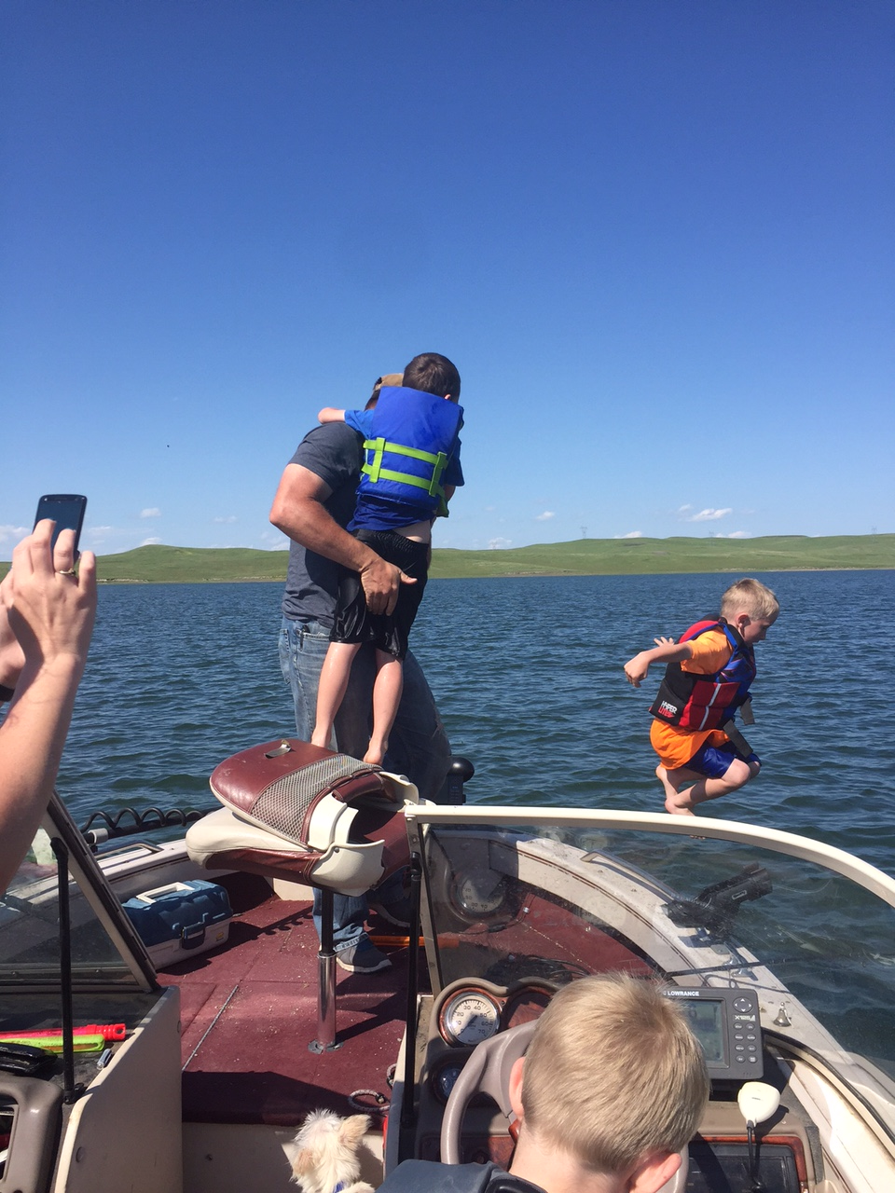
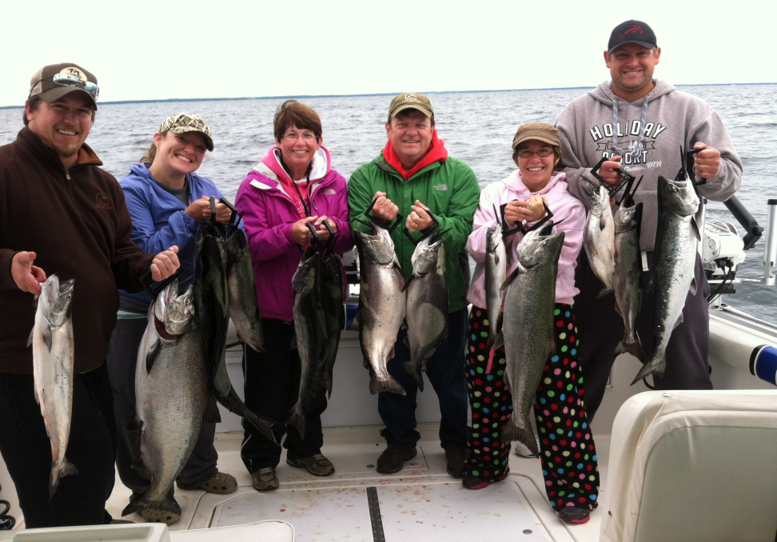
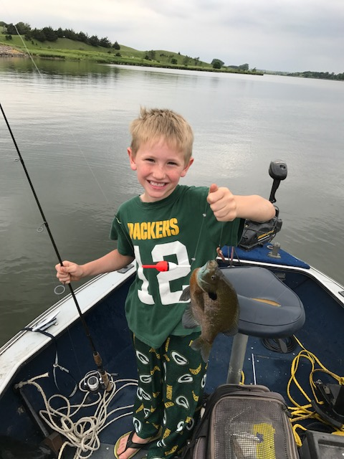
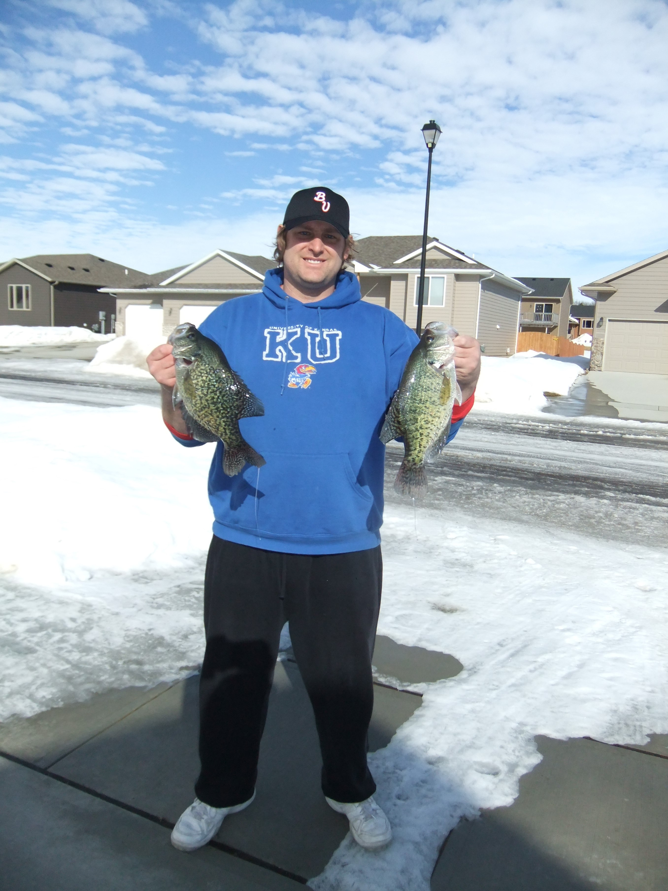
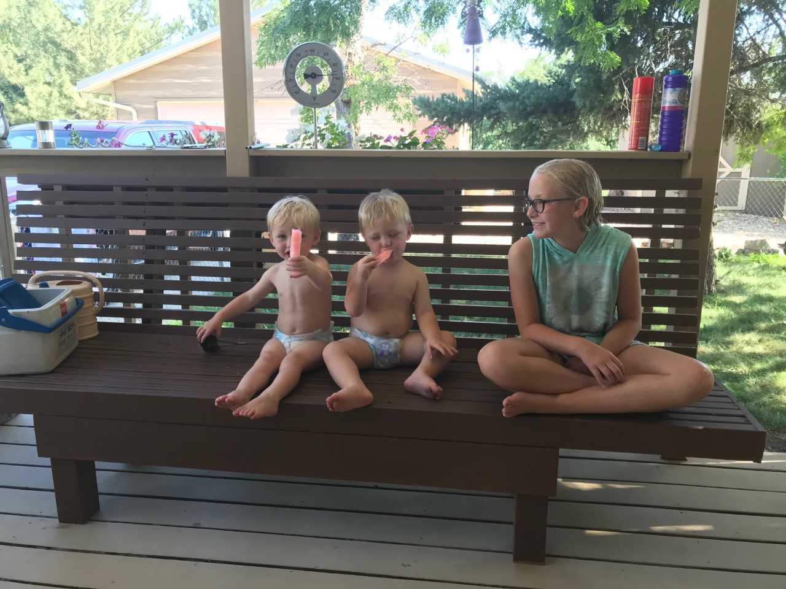
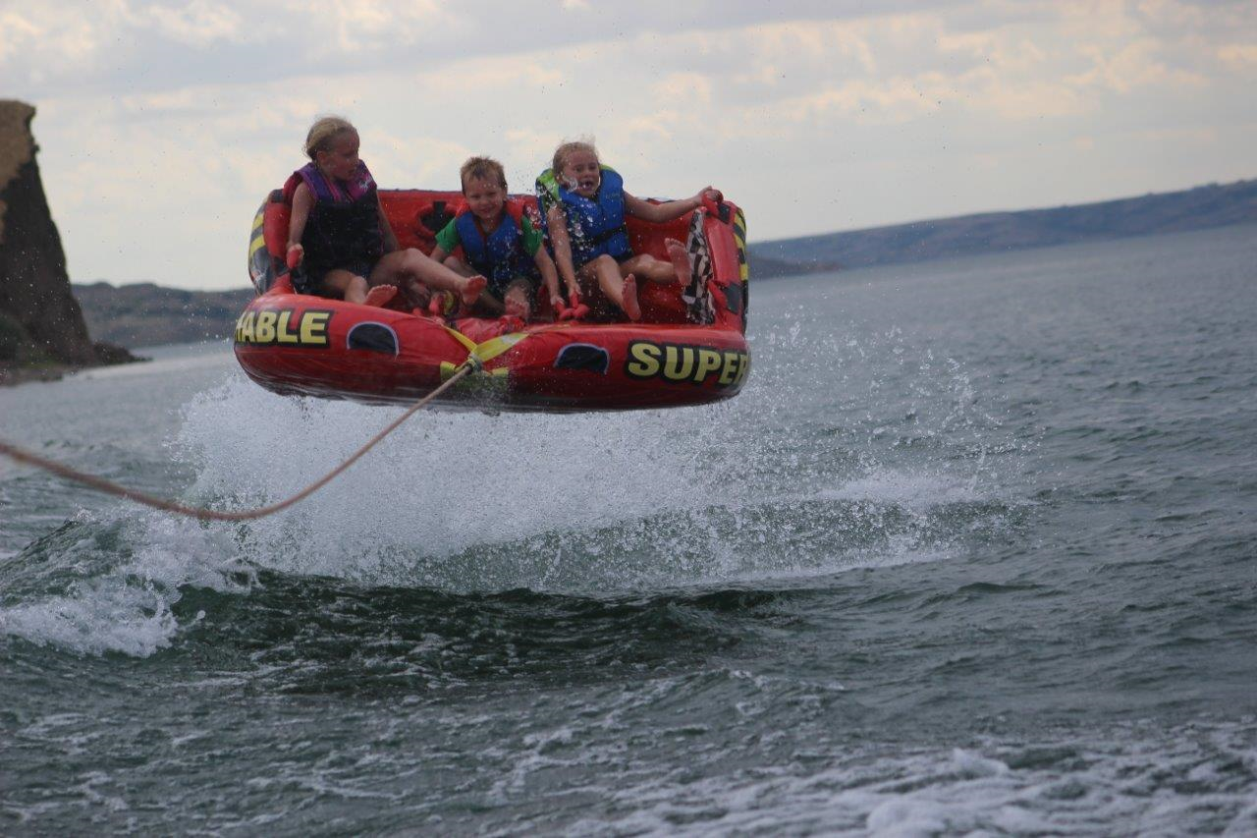
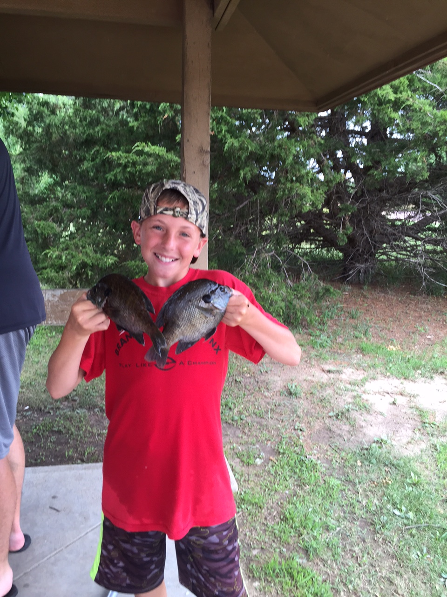
My hobbies outside of school
Fishing, hunting, camping, being outdoors, and anything with my family

Slide 5
What we will cover this year
Quick overview of the discoveries of America
Settlement of the Americas
13 Colonies
The French and Indian War
Causes of the American Revolution
The American Revolution
The Constitution and our new Government
US Presidents
Manifest Destiny
The War of 1812
The Industrial Revolution

Slide 6
What we will cover this year
Slavery
The Underground Railroad
Causes of the Civil War
The Civil War
Reconstruction
The Wild West
Politics

Slide 7
Have A Great Year!!!!
My Email: Jason.Bisbee@k12.sd.us
My Webpage: https://jb186.k12.sd.us/

